Slide 1
oscillator design
→
pulse generation
→
single-bit counting
→
parameter optimization
→
cascade architecture
→
shutdown design
→
full-system coupling
→
global robustness

Slide 2
Engineering TEMPO Through Modeling
↓
1. Building the Clock
What determines timing?
↓
2. Converting Pulses into Counts
When does one pulse produce exactly one flip?
↓
3. Designing the Counter
How strong should BM3R1 be, and do we need degradation?
↓
4. Scaling the Counter
How should carry propagate between bits?
↓
5. Model-Guided Shutdown Redesign
How can expression duration be programmed?
↓
6. Full-System Operating Region
Under what conditions does TEMPO work reliably?
振荡器 ODE；质粒/基因组状态模拟；振荡周期、幅度、pulse width；振荡器 GSA；根据关键参数研究周期调控
将振荡器输出的 C31/integrase 真实波形作为计数器输入；模拟 Integrase + RDF 驱动 PB↔LR；研究“一次振荡脉冲是否对应一次有效翻转”
BM3R1 Hill 方程和参数替换；BM3R1 promoter strength 参数扫描；BM3R1/RDF 表达比例；RDF 残留；是否加入 degradation tag；给实验组启动子强度建议
C 方案：LR→PB 触发的 feed-forward carry pulse generator；二级/三级级联；D 方案：游离正交重组酶级联；二者的时延、可靠性、输入窗口、级联能力比较
shutdown module，与阻遏蛋白/输出模块耦合；模拟关闭过程；扫描 shutdown 强度、delay 等参数；控制 expression duration
强化的oscillator–counter coupling；改变 oscillator period / amplitude / pulse width 后研究计数器表现；研究接入 counter 后对 oscillator 的 load effect

Slide 3
Did the model help the team understand, predict, or design the system?
Design question | Modeling insight | Consequence
How can TEMPO control time? | Identified oscillator parameters controlling period | Tunable clock
How should oscillator and counter connect? | Protein concentration was not the correct interface; production flux must be used | Corrected oscillator-counter coupling
Can one peak equal one count? | Identified one-pulse-one-flip regime | Reliable counting window
How should BM3R1 be expressed? | Defined functional promoter region | Promoter design recommendation
Is degradation required? | Protein persistence affects future cycles | Degradation-tag recommendation
How can carry propagate? | Two distinct mechanisms show different constraints | Defined candidate cascade architectures
How can stable LR produce finite output? | BM3R1 decay can time sRNA activation | Finite expression window
Is shutdown fragile? | Growth and multi-parameter tests retain function | Robustness support

Slide 4
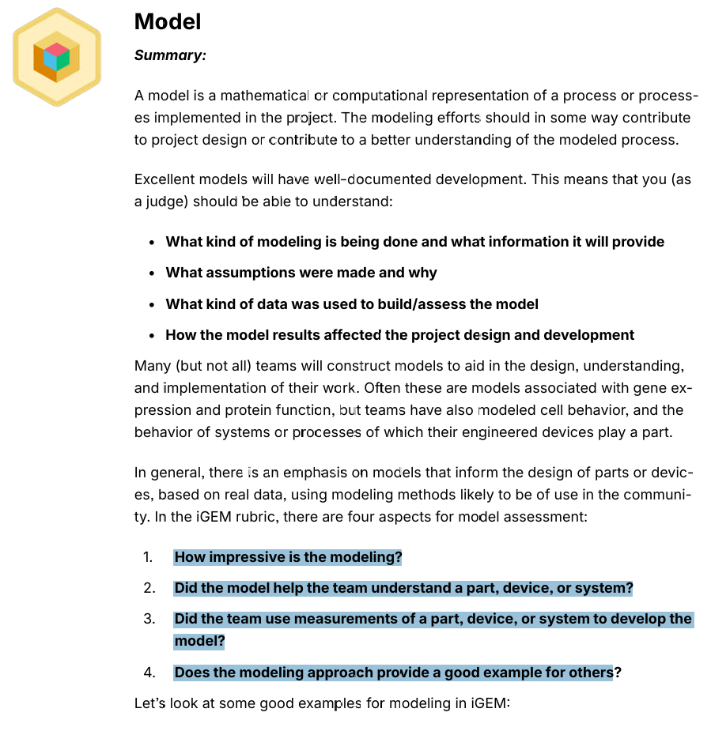

Slide 5
我们做的是以 ODE 为主的 mechanistic modeling，结合参数扫描、全局敏感性分析和系统级耦合分析。它分别用于预测振荡周期与波形、单脉冲翻转条件、计数器参数窗口、多级进位行为、表达时长，以及 oscillator-counter 的可靠工作区。
What kind of modeling is being done and what information it will provide?
每个模块分别写假设，例如 well-mixed、Hill-type regulation、蛋白合成/降解按有效速率表示、正交重组酶之间忽略串扰、DNA 状态转移用有效动力学描述等，并解释这些假设是在“保留与设计决策直接相关动力学”的同时降低模型复杂度。
What assumptions were made and why?
What kind of data was used to build/assess the model?
主要使用已有文献和数据库中的实验参数、原始论文模型参数、BM3R1 等调控元件已有表征数据；可用实验数据若最终有限，则明确作为 supplementary validation，而不是虚构完整实验闭环。
How did model results affect project design and development?
调振荡周期、给 BM3R1 promoter strength 建议、判断 degradation tag 是否需要、比较两种级联架构、识别原设计 expression-duration 缺陷并加入 shutdown、确定 oscillator-counter 的可靠耦合条件。

Slide 6
What kind of modeling is being done and what information it will provide?
We developed a multi-scale mechanistic modeling framework for TEMPO, covering clock generation, pulse decoding, single-bit switching, multi-bit carry propagation, timed output control, and full-system coupling.
Models and Outputs
Cascade model
Shutdown model
Oscillator model
Single-bit counter model
expression duration
shutdown delay
controllable output window
carry timing
false carry
multi-bit state sequence
architecture comparison
period
amplitude
pulse width
parameter dependence
load effect
PB/LR switching
one-pulse-one-flip condition
BM3R1/RDF suitable expression region
degradation requirement
Full coupling model
reliable operating region
oscillator parameter tolerance
counter robustness

Slide 7
What assumptions were made and why?
每个章节都写“Assumptions & Rationale”
每个人写自己负责的部分
例如振荡器：
intracellular environment is well mixed
transcription and translation are represented by effective kinetic terms
degradation/dilution are modeled as first-order processes
plasmid copy number or genomic copy number is treated as fixed within a simulation
……
+ why
These assumptions allow us to focus on the dynamic features most relevant to TEMPO — period, pulse shape, and downstream load — while keeping the model identifiable and computationally tractable.

Slide 8
What kind of data was used to build/assess the model?
A. Parameterization data
B. Benchmarking / reproduction data
oscillator 原论文中的 kinetic constants
integrase/RDF 文献动力学
BM3R1 experimentally characterized response curves
degradation constants
promoter strength data
先复现已有系统：We first reproduced the published oscillatory behavior / switching behavior before extending the model to TEMPO.
说明不是从零乱写
C. Independent assessment data
能拿来比较的文献数据

Slide 9
How did model results affect the project design and development?
Modeling finding | Design consequence
Oscillator period is sensitive to specific parameters | Identified tunable clock parameters
Real oscillator pulses differ from ideal square waves | Used simulated biological waveform as counter input
BM3R1 expression strongly affects switching window | Recommended promoter strength range
Protein persistence can impair subsequent switching | Evaluated need for degradation tags
Carry propagation differs between two mechanisms | Compared and selected/scoped cascade architectures
Original output design causes overly long expression | Added shutdown module
Shutdown timing depends on regulatory parameters | Tuned expression duration
Counter load perturbs oscillator dynamics | Incorporated load-aware oscillator design
Only part of pulse-parameter space gives reliable counting | Defined TEMPO operating window

Slide 10
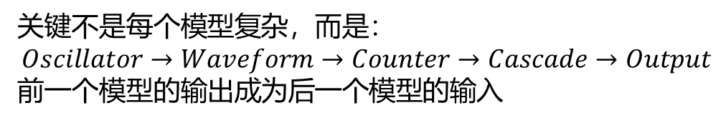
How impressive is the modeling?
第一：跨度
覆盖：
molecular regulation → DNA switching → multi-bit logic → system coupling → timed output
不是一个局部模型
第二：集成
关键不是每个模型复杂，而是：
$$Oscillator→Waveform→Counter→Cascade→Output$$
前一个模型的输出成为后一个模型的输入
不是拟合曲线，而是做：
parameter selection
architecture selection
failure diagnosis
redesign
operating-window determination
第三：工程用途

Slide 11
Did the model help the team understand a part, device, or system?
Part level
BM3R1 / RDF / degradation behavior
Device level
oscillator、single-bit recombinase switch、shutdown
System level
oscillator-counter coupling、binary cascade

Slide 12
Did the team use measurements of a part, device, or system to develop the model?
现在我们好像确实没有什么实验支撑。。
Our models were grounded in published experimental measurements of the oscillator, recombinase systems, repressors, and degradation kinetics. Where available, our own experimental measurements were used for additional comparison, while system-level predictions were assessed through literature benchmarking, sensitivity analysis, and robustness testing.

Slide 13
Does the modeling approach provide a good example for others?
代码开源
README
parameter tables
clear model diagrams
reusable input interface
standard waveform CSV
one-click simulation
example parameter sets
Other teams can reuse our framework by replacing:
oscillator parameters
repressor transfer functions
recombinase kinetics
pulse input
desired counting depth

